Slide 1
Exceptions & Exception Handling

Slide 2
How can errors be handled?

Slide 3
Errors in Your Code
Three major types of errors
Syntax
A problem with the code itself
Prevents your program from compiling/running
Run-Time
A problem that occurs as the program is running
Usually “crashes” your program
Logic
Program runs but produces unexpected results

Slide 4

Handling Syntax Errors
Syntax errors:
A problem with the code itself
Prevents your program from compiling/running
What does Visual Studio do?
Visual Studio helps with syntax errors
Gives us useful error messages
Uses Intellisense (red squiggly lines)
What do WE need to do?
Correct spelling
Check for re-declaration of variables
Call methods that exist
etc.

Slide 5
Handling Run-Time Errors
Run-Time errors:
A problem that occurs as the program is running
Usually “crashes” your program
What does Visual Studio do?
Debugger system (breakpoints, stepping through, F5)
Breakpoints and stepping through code help us to “see” the path our code takes
Can help us to understand the point which a program crashes

Slide 6
Handling Run-Time Errors
What do WE need to do?
Attempt to prevent the errors
Check variable values before use
Use TryParse()
Use conditionals to allow certain code to occur if a value is ok
Force the user to re-enter invalid input
If the error is related to user input
“Enter a number between 0 – 10”
Let the program crash
Probably not a great idea

Slide 7


Unavoidable Errors
You should prevent errors as much as possible!
Do all the things!!
Use TryParse().
Check variable values.
Use conditionals to ensure valid data
Require user to re-enter data.
Use Contains() to determine if data is inside list.
Check for null values.
But…
Sometimes you just can’t prevent an error.
Maybe you don’t know if the error will occur
Maybe the error is out of your control

Slide 8
Exceptions

Slide 9
Exceptions
All C# run-time errors are exceptions
You’ve seen this before in your coding…
NullPointer Exception
KeyNotFound Exception
IndexOutOfRange Exception
InvalidOperation Exception
What does it actually mean?

Slide 10
Exceptions
Exceptions are technically objects.
Created automatically by C# when things go wrong
You can also create them if necessary
Exceptions represent errors that occur while your program is running.
Your code can interact with these exceptions.
Helpful for developers, not for users

Slide 11
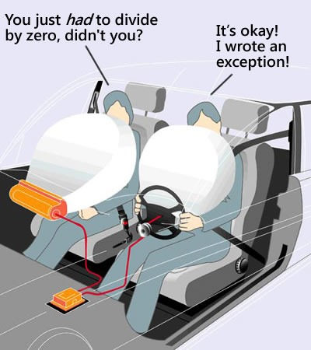
How Exceptions Are Created
C# detects something went wrong – cannot perform requested action
It creates an exception object
Instantiated like any other object
Its properties are set
(This happens behind the scenes)
The exception is then thrown
How the rest of the program is notified
“This exception object exists! Something happened!”
If not handled properly, the program will crash
“An exception! Abort! Ship’s going down!”

Slide 12
Exception Objects
Similar to other objects you’ve used
Contain fields, methods and properties
Like .Count in the List class
Exception object
message
Message
(property)
Returns message field
Example of a useful property is .Message
Contains the actual error message
The same one you see when the program crashes
Display this in a C.WL() to get detailed information about the Exception object
Exception objects are created by Visual Studio when something goes wrong.

Slide 13
Why?
The Exception is a way that one part of your code can communicate to another.
Hey, line of code that’s calling a statement that caused an exception…
What you’re asking for cannot be accomplished!
Do something else instead!

Slide 14
What kind of communication?
List<int> myNumbers = new List<int>();
myNumbers.Add(5);
myNumbers.Add(10);
myNumbers.Add(15);
int valueInElement24 = myNumbers[24];
The List class is communicating with Main that what we’re asking for (get index 24 in a list of only 3 elements) cannot be done!
It does this by causing an exception.
It’s OUR job to decide what to do with it.

Slide 15
Detecting exception communication
What if I told you we can stop a crash from happening?!?
Can write code to detect that an exception was made, and then
React to them however we want!
Run alternate code instead
If we properly handle the exception...
Our program never actually crashes!

Slide 16
Try and Catch

Slide 17
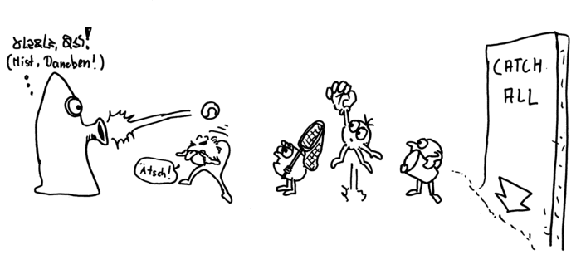
Catching Exceptions
Exceptions that are thrown must be caught
If not, they will cause your program to crash
A special code block will catch exceptions: The try/catch block
Ack! Error!
Throw an exception!
Crash
land
catch
catch
catch
catch

Slide 18
Try/Catch Example
try
{
CodeThatMightThrowExceptions();
//If the code in here causes an exception,
it will NOT crash the program
}
catch (Exception myExceptionVariable)
{
//Instead, the code in here will run
DoSomethingUsefulInstead();
}

Slide 19
Try/Catch – Deeper Look
No parentheses
try
{
CodeThatMightThrowExceptions();
//If the code in here causes an exception,
it will NOT crash the program
}
catch (Exception myExceptionVariable)
{
//Instead, the code in here will run
DoSomethingUsefulInstead();
}
Declare a new Exception object, kind of like a parameter

Slide 20
Try/Catch “Rules”
To catch an exception:
It must be thrown inside a try block
Exceptions occurring outside a try cannot be caught
Once the exception occurs:
The rest of the code in the try is skipped
The program immediately jumps to the catch block

Slide 21
Another Example
try
{
int x = 10;
int y = 0;
int result = x / y; //Dividing by zero causes an error!
Console.WriteLine(“This will NOT show up!”);
}
catch (Exception ex)
{
//This will write the exception’s actual message
to the user
Console.WriteLine(ex.Message);
}

Slide 22
Scope Issues
Remember that { }’s act like boundaries
Variables declared in the try block cease to exist outside
They will NOT be available in the catch

Slide 23
Scope Issue - Example
try
{
int result = x / y;
}
catch(Exception e)
{
result = -1;
// Problem: Variable ‘result’ does NOT exist here!
}
May give a divide-by-zero error
Set a default result value if things go wrong

Slide 24
Fixed Scope Issue - Example
Define variable outside of the blocks
int result = 0;
try
{
result = x / y;
}
catch(Exception e)
{
result = -1;
}
Don’t re-define variable
Set default value if there’s an error

Slide 25
Catching Multiple Exceptions

Slide 26
Catching different exceptions
There are many different exception classes
Ranging from general to specific
Example: DivideByZeroException
All exception classes inherit from “Exception”
Base class for all exceptions
We can catch any type of exception

Slide 27
Exception hierarchy
Exception
SystemException
IndexOutOfRange Exception
NullReference Exception
Application Exception
Argument Exception
ArgumentNull Exception
The exceptions we’re working with will come from the SystemException “branch” (yellow),
not the ApplicationException branch (orange).
Notes:
If code could potentially give a few of these errors, we can handle each one in a different catch block

Slide 28
Multiple exceptions
Q: What if a method can throw multiple exceptions?
A: They will all be caught by the single catch, regardless of exception type.
Q: What if we want to handle them differently?
A: Use multiple catch blocks and specify a different exception type in each block

Slide 29
Multiple exceptions - Example
try
{
// Code that could throw multiple exceptions
}
catch(IndexOutOfRangeException e)
{
// Handle only index out of range exceptions here
}
catch(SomeOtherException e)
{
// Handle a different kind of exception here
// Obviously SomeOtherException is not a valid C#
// exception that exists. ☺
}

Slide 30
Are these equivalent? (Exception order)
try
{
}
catch(Exception e)
{
}
catch(ArgumentException e)
{
}
try
{
}
catch(ArgumentException e)
{
}
catch(Exception e)
{
}
No. In fact, the left one won’t even compile!
Exceptions must be caught in a particular order: Most-specific to most-general
If the most general exception comes first:
The first catch block will capture all exceptions
C# considers that a syntax error
Notes:
:Polymorphism – all child classes are of the parent type, too, so all exceptions are caught before the more specific exceptions are caught

Slide 31
Exception order
Exceptions must be caught in a particular order
Most-specific to most-general
If the most general exception comes first
The first catch block will capture all exceptions
C# considers that a syntax error

Slide 32
Guidelines to Exceptions

Slide 33
One Last Thing
Remember: Preventing exceptions is FAR better than catching exceptions
A simple if statement is much faster than:
C# detecting an error
And generating an object
And throwing the exception
And catching it
Use try/catch where necessary
It’s not a replacement for basic error checking!

Slide 34
So... When should you catch exceptions?
When you cannot prevent them from happening!
You CAN prevent:
Index out of range
Bad user data
Calling the wrong method on the wrong object
Incompatible type casting
Calling a method or accessing a property on a null reference
You CANNOT prevent:
Invalid file access

Slide 35
Throwing Your Own Exceptions

Slide 36
Can I throw an exception too?
We have the power to make Exceptions happen!
Imagine you are writing a List class… And someone wants to retrieve index 24 in a list with a count of 2...
What would your code do?
Allow the crash to happen? No – that’s a bad interface.
Return a default value (0 for ints, false for bools, etc.) so that the user thinks that 0 is at index 24? No – that’s misleading.
Just like the built-in C# list class does, we can force the program to throw an exception!

Slide 37
Throwing exceptions?
You should throw your own exceptions when…
When your code can’t actually complete the specified task!
For instance:
Your method accepts the name of a player to return, but that player doesn’t exist. You can’t actually return a player – so throw an Exception!
Why not just return null?
Null means there is no pointer, but
The exception explicitly means “I cannot do what you want me to”

Slide 38
Using exceptions
What does an exception really represent?
Something going wrong
So wrong that the current method can’t operate
Exceptions are a way to notify a different part of your code (another method or class) when errors occur

Slide 39
Throwing your own exceptions
C# has a throw keyword
Your job is to: Create an exception object, then throw it yourself
The current method will immediately end
Exception ex = new Exception(“Error message”);
throw ex;
One line version:
throw new Exception(“Error message”);

Slide 40
Throwing - Example
// Asks for the name of a Player, then returns the Player object with a matching Name property
public Player GetPlayerByName(string name)
{
foreach(Player currentPlayer in playerList)
{
if(currentPlayer.Name == name )
return currentPlayer;
}
// If we got here, the player doesn’t exist!
// We can’t actually carry out the task.
// (Notice there is no return statement here)
throw new Exception(“Player not found!”);
}

Slide 41
Throwing vs. return
In the previous example, there’s no return at the very end of the method
Throws can be used IN PLACE of a return statement! They BOTH immediately end the method.
Throwing is a valid way to end a method, even if the method requires a return value
It immediately ends the method
The rest of the code will not run

Slide 42
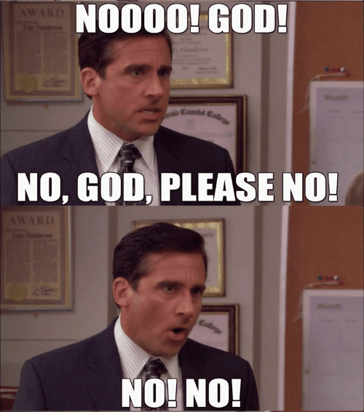
Where do I catch my throws?
NOT INSIDE THE SAME METHOD WHERE YOU THROW THEM!
public static void MethodThatCouldThrowAnException(bool problem)
{
try
{
if( problem == true )
{
throw new Exception();
}
}
catch(Exception e)
{
Console.WriteLine(“There was a problem!”);
}
}

Slide 43
Where do I catch my throws?
Do this instead:
public static void MethodThatCouldThrowAnException(bool problem)
{
if( problem == true )
{
throw new Exception();
}
}
Catch this OUTSIDE of this method!
Catch it wherever you are calling MethodThatCouldThrowAnException()!

Slide 44
Where do I catch my throws?
Catch the exception wherever you are CALLING the method that throws the exception!
public static void Main(string[] args)
{
try
{
MethodThatCouldThrowAnException();
}
catch(Exception e)
{
Console.WriteLine(“There was a problem!”);
}
}
YES YES YES YES YES YES YES YES YES YES YES YES

Slide 45
So where should I catch?
If you’re throwing an exception…
Generally means the method CAN’T go on
Things have gone wrong! Abort mission!
If the method CAN go on…
It’s not an exceptional circumstance
Don’t throw an exception!
Use other error handling techniques

Slide 46
More specific exceptions
C# comes with many exception classes
IndexOutOfRangeException
DivideByZeroException
NullReferenceException
FormatException
And more
Most are used by C# for specific errors
They inherit from SystemException, which inherits from Exception
They might not make sense for all errors
Especially for errors in your own methods

Slide 47
One last time... Where Should I Catch? Example
Try/Catch here
Throw here, don’t catch
static void Main(...)
{
try
{
DoStuff(10);
DoStuff(-2);
}
catch(Exception e)
{
// We catch here!
}
}
void DoStuff(int value)
{
// Check for invalid
// parameter data
if( value < 0 )
throw new Exception();
// Data is valid - do
// something useful
// here.
...
}

